Slide 1

Unit - 3
Memory Management

Slide 2
Memory Management: Memory view of a process
Definition
Memory management is the process of managing the allocation and deallocation of memory among different processes in a computer system.
OR
Memory Management is an operating system function that manages and controls the main memory (RAM) by allocating memory to processes when they need it and deallocating it when they finish.
Main Functions of Memory Management
Memory Allocation – Gives memory space to processes.
Memory Deallocation – Frees memory after a process finishes.
Memory Protection – Prevents one process from accessing another process's memory.
Memory Sharing – Allows processes to share memory when required.
Address Translation – Converts logical/virtual addresses into physical addresses.
Example:
When you open a web browser, the OS allocates RAM to the browser. When you close it, the OS releases that memory so another program can use it.

Slide 3
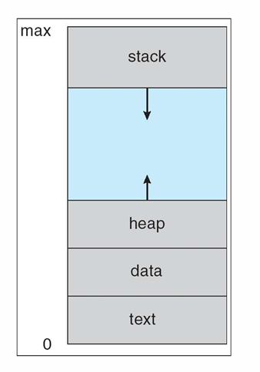
Memory view of a process
The memory view of a process describes how a process is organized inside the main memory (RAM) while it is executing.
When a program is loaded into memory, its memory is divided into different sections.
1.Text Segment: A text segment, also known as a code
segment or simply as text ( which contains executable instructtions)
OR
The text segment contains the actual instructions of the program.
Example: int main()
{
printf("Hello");
}
The machine instructions generated from this program are
stored in the text segment.

Slide 4
Cont..
2.Data Segment :
Initialized - the global variables and static variables that
are initialized by the programmer.
OR
The data segment stores initialized global and static variables.
Example: int x = 10;
static int y = 20;
x and y are initialized variables, so they are stored in the data segment.
b) Uninitialized Data Segment- often called the “bss”
segment,( “block started by symbol.”)
It stores uninitialized global and static variables.
Example: int x;
static int y;
No initial value is given to these variables, so they are placed in the BSS segment.
The operating system initializes them to 0 when the process starts.

Slide 5
Cont..
3.Heap: Heap is the segment where dynamic memory allocation usually takes place.
The process of assigning computer memory space during a program's execution (runtime) rather than at compile time
OR
The heap is used for dynamic memory allocation.
int *p;
p = (int *)malloc(sizeof(int));
The memory obtained using malloc() comes from the heap.
examples:
malloc() :Allocates a single block of contiguous memory;
contents are uninitialized (contain garbage values).
calloc() : Allocates multiple blocks of memory for an array;
automatically initializes all bytes to zero.
realloc() : Changes or resizes the size of a previously allocated memory block.
The heap generally grows upward toward higher memory addresses.

Slide 6
Cont..
4.Stack: Each time a function is called, the address of where to return
to and certain information about the caller’s environment. (when the
stack pointer met the heap pointer, free memory was exhausted.)
OR
The stack is used for temporary data associated with function execution.
It contains: Local variables
Function parameters
Return addresses
Function call information
Example:
void fun()
{
int x = 10;
}
The local variable x is stored in the stack.
The stack generally grows downward toward lower memory addresses.

Slide 7
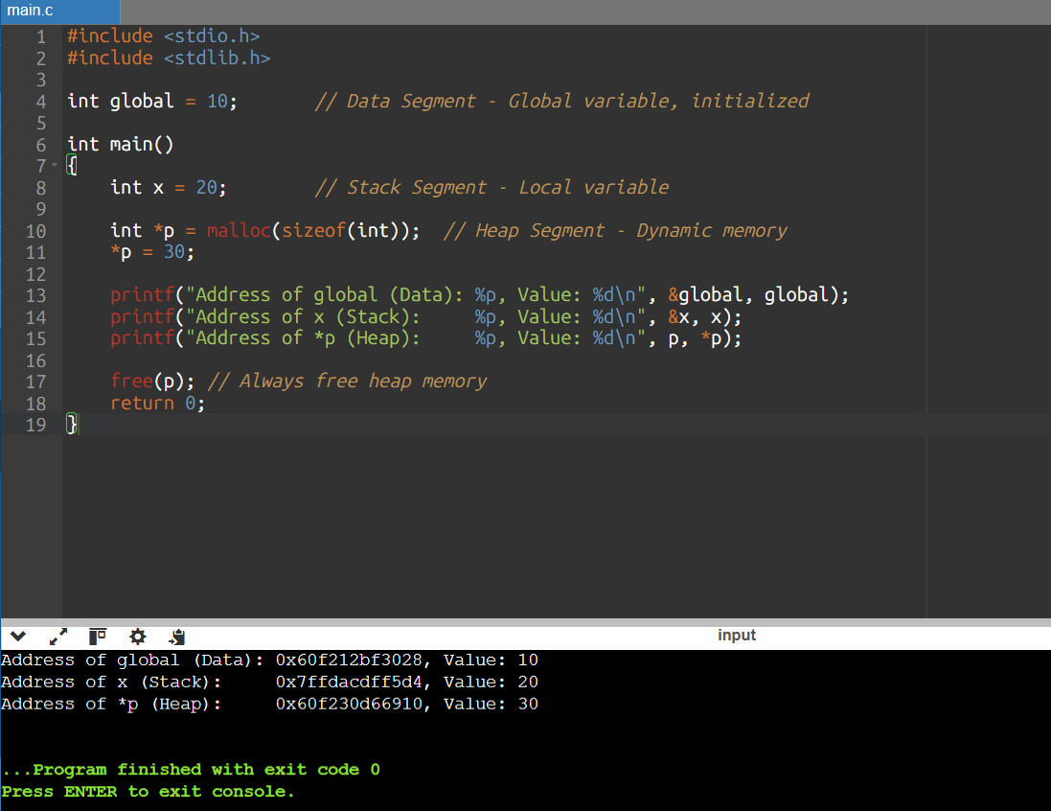
Cont..

Slide 8
MEMORY VIEW OF A PROCESS: FEW MORE CONCEPTS
Context Switching:
When the CPU switches between different processes, it must also switch their memory views.
This switch involves saving and restoring the process's registers, program counter, and memory mapping.
Virtual Memory:
Virtual memory is a memory management technique in which secondary memory can be used as part of the main memory
Virtual memory allows processes to have the illusion of having their own dedicated memory space, even though they share physical RAM with other processes.
This abstraction simplifies memory management and enhances security

Slide 9
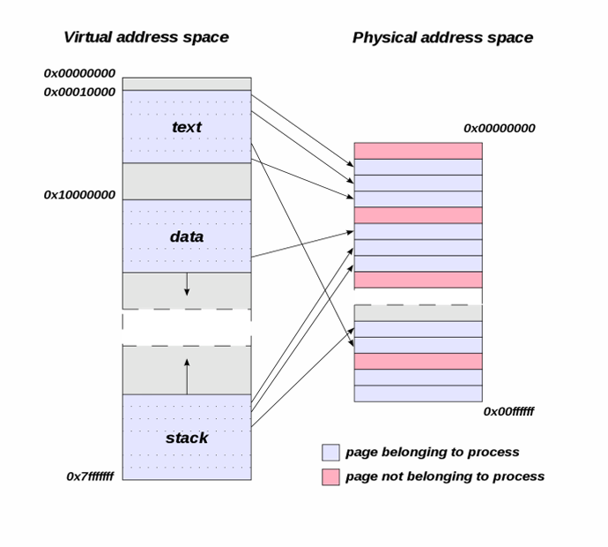
MEMORY VIEW OF A PROCESS: FEW MORE CONCEPTS
Address Space:
Each process in an operating system
is allocated its own virtual address
space, which can range from a few
megabytes to several gigabytes,
This virtual address space is
divided into various regions or
segments, such as code, data,
heap, and stack.

Slide 10
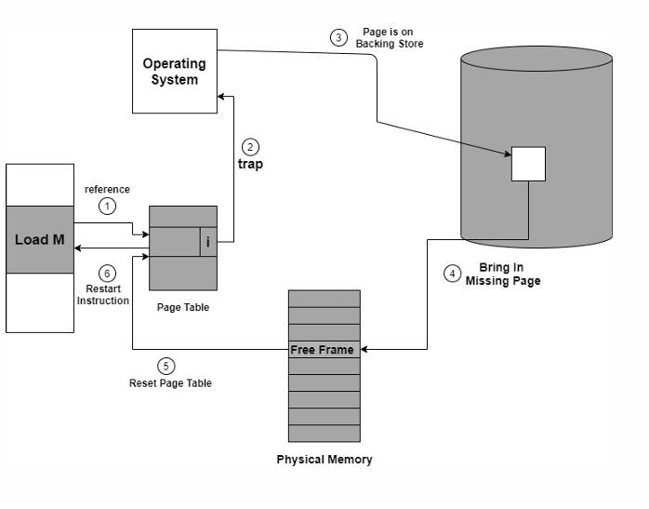
MEMORY VIEW OF A PROCESS: FEW MORE CONCEPTS
Page Faults:
If a process tries to access a virtual
memory address that is not
currently in physical memory (i.e., a page fault)
Operating system is responsible for bringing
the required page from secondary storage
(e.g., the hard drive) into physical memory

Slide 11
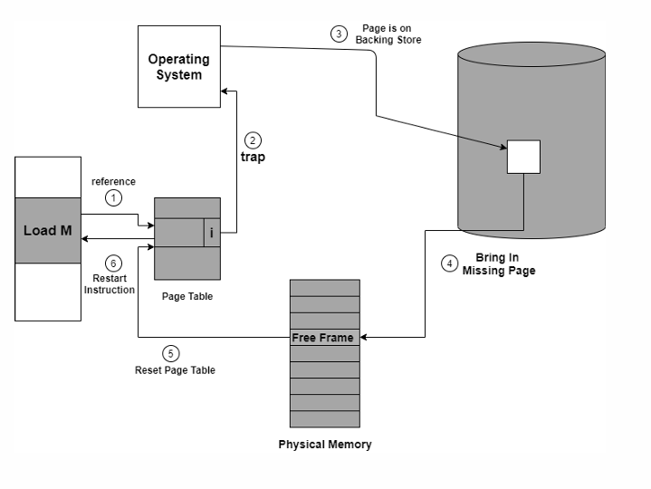
MEMORY VIEW OF A PROCESS: FEW MORE CONCEPTS
Address Translation:
Under virtual memory, the process’s
virtual addresses must be translated
to physical memory addresses by the
operating system's memory
management unit (MMU).
This translation allows multiple
processes to coexist in memory
without interference.

Slide 12
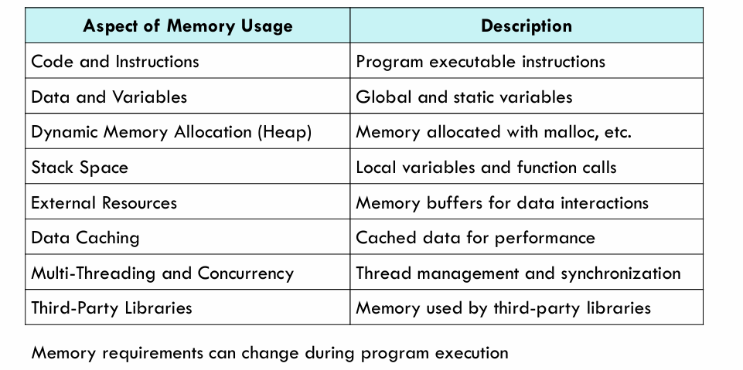
Process memory usage requirements

Slide 13
Virtual and physical memory-related system calls (mmap, munmap, sbrk, mprotect).
A computer's memory system has two key concepts: physical memory (the actual hardware) and virtual memory (a software abstraction)
Physical vs. Virtual Memory
Physical Memory is your computer's RAM (Random Access Memory). It's the actual hardware component that stores data and program instructions for quick access by the CPU. Physical memory is finite, and its addresses are unique and directly correspond to physical locations on the RAM chips.
Virtual Memory is a memory management technique that gives each process the illusion that it has a large, continuous block of memory to itself. This "virtual address space" is much larger than the available physical RAM.
The operating system, using a component called the Memory Management Unit (MMU), translates these virtual addresses into physical addresses. When a program tries to access a virtual address that isn't currently in physical memory, it triggers a page fault, and the OS loads the required data from the hard drive into RAM. This process, known as paging, allows the system to run more programs than would fit in physical memory alone, albeit at a slower speed.
System calls are a way for a user-space program to request services from the operating system kernel.

Slide 14
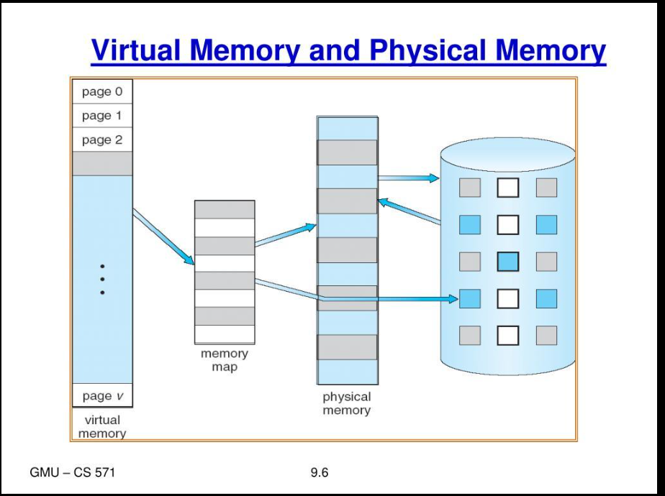
Cont..
How Virtual Memory Works
Virtual memory uses both hardware and software to manage memory.
When a program runs, it uses virtual addresses (not real memory locations).
The computer system converts these virtual addresses into physical addresses (actual locations in RAM) while the program runs.

Slide 15
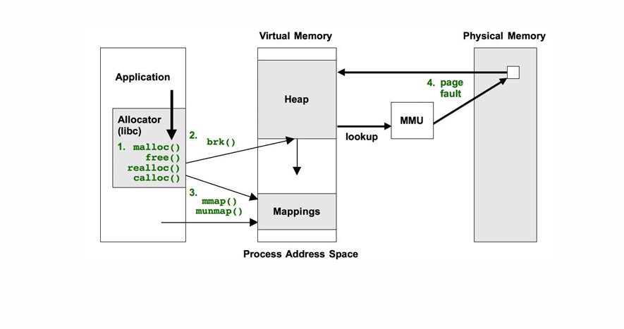
SYSTEM CALLS: VIRTUAL MEMORY AND PHYSICAL MEMORY

Slide 16
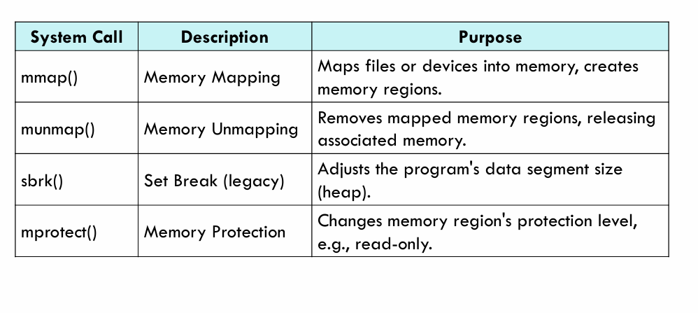
Virtual and physical memory-related system calls (mmap, munmap, sbrk, mprotect).

Slide 17
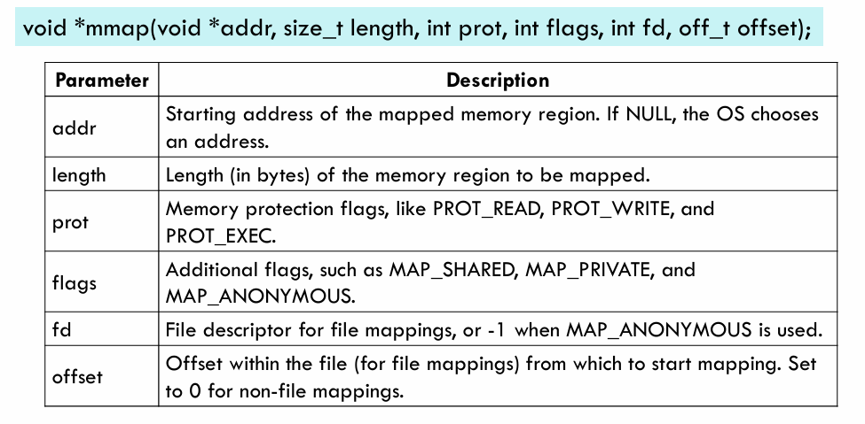
1.mmap() — Map Memory
mmap() is used to create a new memory mapping in a process's virtual address space.
mmap() asks the OS to give a process a region of virtual memory.
Syntax:

Slide 18
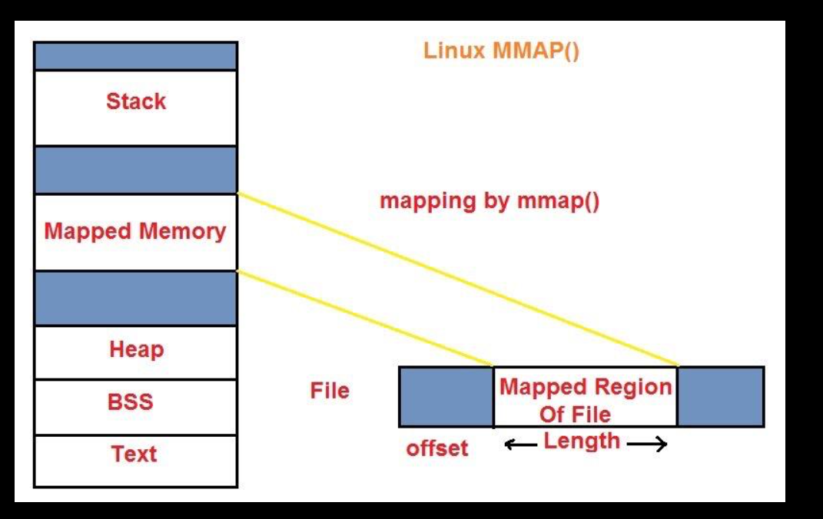
Cont..

Slide 19
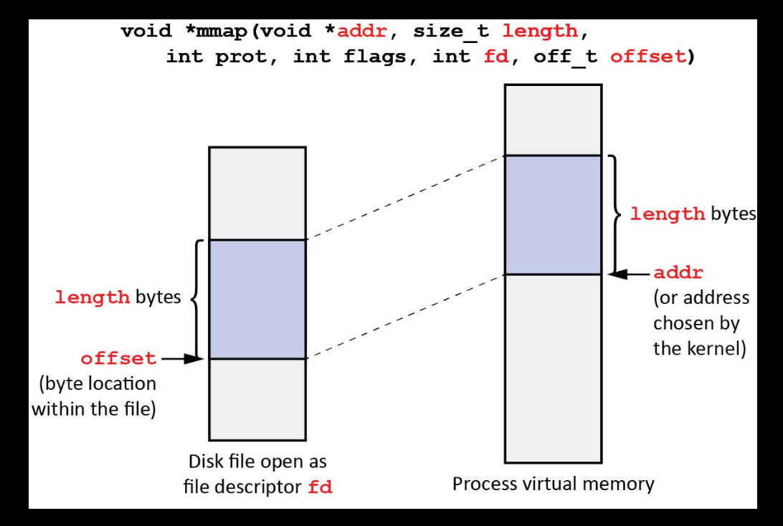
Cont..

Slide 20
Cont..
The mmap() function in C returns a pointer to the starting address of the memory region that was mapped if the operation is successful.
If mmap() encounters an error, it returns MAP_FAILED.
Example
int *p;
p = mmap(NULL, 4096,
PROT_READ | PROT_WRITE,
MAP_PRIVATE | MAP_ANONYMOUS,
-1, 0);
Here:
4096 → requests 4096 bytes of virtual memory
PROT_READ → memory can be read
PROT_WRITE → memory can be written
MAP_ANONYMOUS → memory is not mapped to a file
p → points to the newly mapped memory

Slide 21
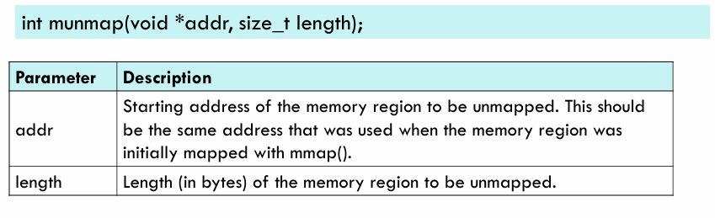
2. munmap() — Unmap Memory
munmap() is used to remove a memory mapping created by mmap().
munmap() tells the OS that the process no longer needs that mapped memory region.
Syntax:

Slide 22
Cont..
The munmap() function in C returns 0 on success and -1 on failure.
If munmap() is successful, it indicates that the specified memory region has been unmapped, and any associated memory is released.
In case of an error, munmap() returns -1, and you can check the errnovariable for details on the specific error that occurred.
Example:
munmap(p, 4096);
This releases the 4096-byte mapping starting at address p .

Slide 23
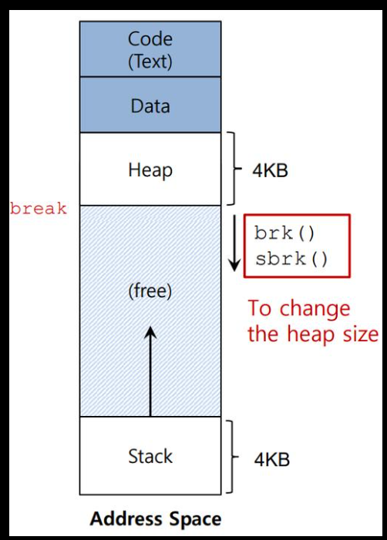
3.sbrk() — Change Process Heap Size
sbrk() is used to increase or decrease the size of a process's data segment/heap by changing the program break.
The program break is the address that represents the end of the process's heap.
Syntax: void *sbrk(intptr_t increment);
increment:
An intptr_t type representing the number of
bytes by which to increase or decrease the program’s
data segment (heap).
If increment is positive, it increases the data segment;
if negative, it decreases it.

Slide 24
Cont..
The return value of sbrk() is a pointer to the beginning of the newly allocated region if it is successful
or (void *)-1 (Invalid pointer)
Example:
void *p;
p = sbrk(4096);
This requests an increase of the heap by 4096 bytes.

Slide 25
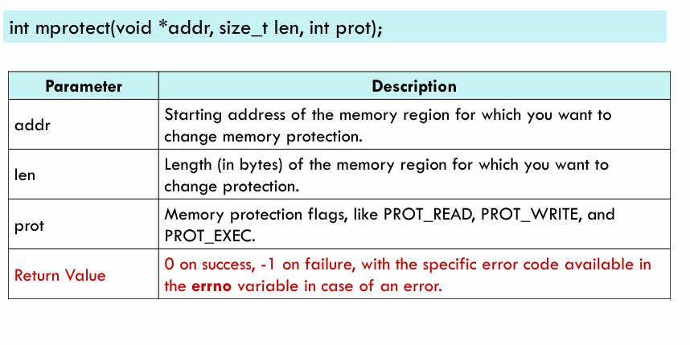
4.mprotect() — Change Memory Protection
mprotect() is used to change the access permissions of an existing memory region.
mprotect() decides whether a memory region can be read, written, or executed.
Syntax:

Slide 26
Cont..
Example:
mprotect(p, 4096, PROT_READ);
Now the region can be read, but writing to it is not permitted.
Difference Between the Four
System Call | Main Purpose
mmap() | Create/map a memory region
munmap() | Remove a memory mapping
sbrk() | Increase/decrease process heap
mprotect() | Change memory access permissions

Slide 27
Address translation mechanisms static mapping
Address translation is the process of converting a logical (virtual) address generated by the CPU into a physical address in main memory (RAM).
1. Static Mapping
In static mapping, the logical address is mapped to a physical memory address before the program starts executing.
The mapping remains fixed during execution.

Slide 28
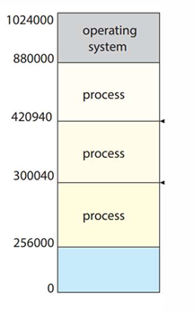
WHAT IS MAIN MEMORY?
It is a crucial component of a computer’s
architecture.
Referred to as primary memory or Random
Access Memory
Holds currently running programs, application
data, and the operating system.
Operating System resides in a part of memory
It's a volatile form of memory
Access time is less as compared to hard disk.

Slide 29
WHAT IS MEMORY MANAGEMENT?
Memory management is the process of
Subdividing the memory among different processes and
Managing operations between main memory and disk during process execution
In order to achieve high memory utilization

Slide 30
SWAPPING
When ever a process is to be executed it must reside in main memory-Why?
Swapping is a process of swapping two processes between secondary memory (disk) and the main memory (RAM)
When a higher priority process arrives and wants the service of CPU, the memory manager swaps out the lower priority process and then load and execute the higher priority process
Example:
RAM has 4 GB with Process A and Process B running, each using 2 GB. When Process C, which also requires 2 GB, needs to run, there is no free memory. The operating system swaps Process A out to the disk and loads Process C into RAM. After Process C finishes, Process A is brought back into memory to continue execution.

Slide 31
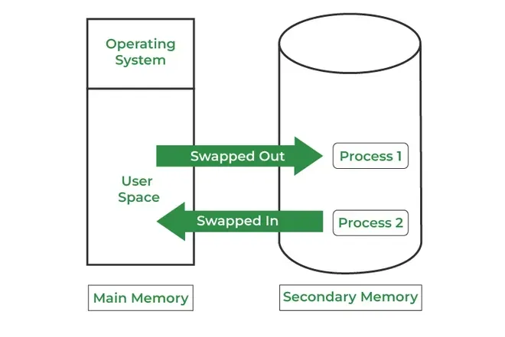
Cont..
How it Works:
A process is moved into RAM from disk
when it is ready to execute.
After the process has run for a while (or if higher-
priority processes need memory), it may be temporarily
swapped out to disk.
The CPU scheduler decides which process to swap in
and out, often based on priority or scheduling policies.
When the swapped-out process is needed again, it is
swapped back into memory to continue execution.

Slide 32
LOGICAL ADDRESS AND PHYSICAL ADDRESS
Logical Address :
It is the address generated by the CPU
Logical address space is the set of memory locations allotted to a process.
A logical address can be changed.
Physical Address:
“Physical Address” or “Real Address” is the address seen by the memory unit which is loaded into the RAM
The set of all physical addresses corresponding to these logical addresses is known as Physical address space.
The run-time mapping from virtual to physical addresses is done by a hardware device Memory Management Unit(MMU).
It always remains constant.

Slide 33
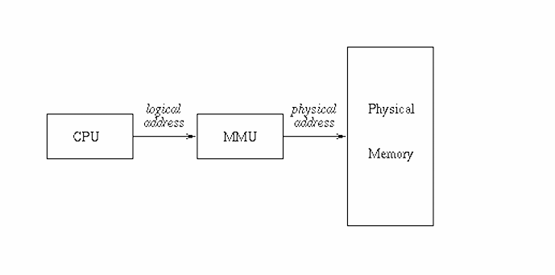
LOGICAL ADDRESS AND PHYSICAL ADDRESS

Slide 34
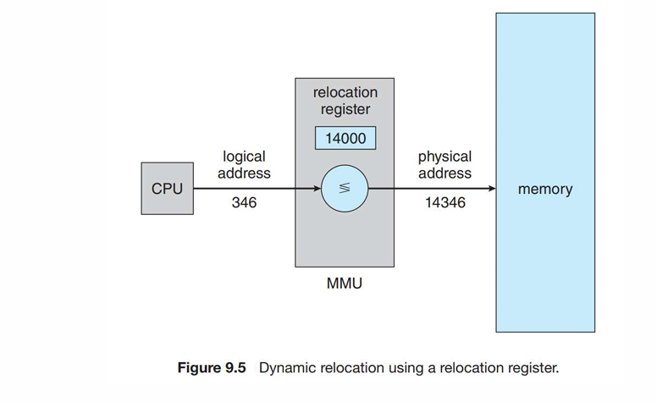
ADDRESS TRANSLATION
Both logical and physical addresses are used to identify a specific location in memory.
Each address type can be represented in different formats such as binary, hexadecimal, or decimal.
They have a finite range, which is determined by the number of bits used to represent them.

Slide 35
Cont..
MMU(Memory Management Unit) :
The run time mapping between Virtual address and Physical Address is done by a hardware device known as MMU.
In memory management, the Operating System will handle the processes and move the processes between disk and memory for execution . It keeps track of available and used memory.
CPU will generate logical address for eg: 346
MMU will generate a relocation register (base register) for eg: 14000
In memory, the physical address is located eg:(346+14000= 14346)
The value in the relocation register is added to every address generated by a user process at the time the address is sent to memory. The user program never sees the real physical addresses.
The program can create a pointer to location 346, store it in memory, manipulate it, and compare it with other addresses—all like the number 346.
The user program generates only logical addresses. However, these logical addresses must be mapped to physical addresses before they are used.

Slide 36
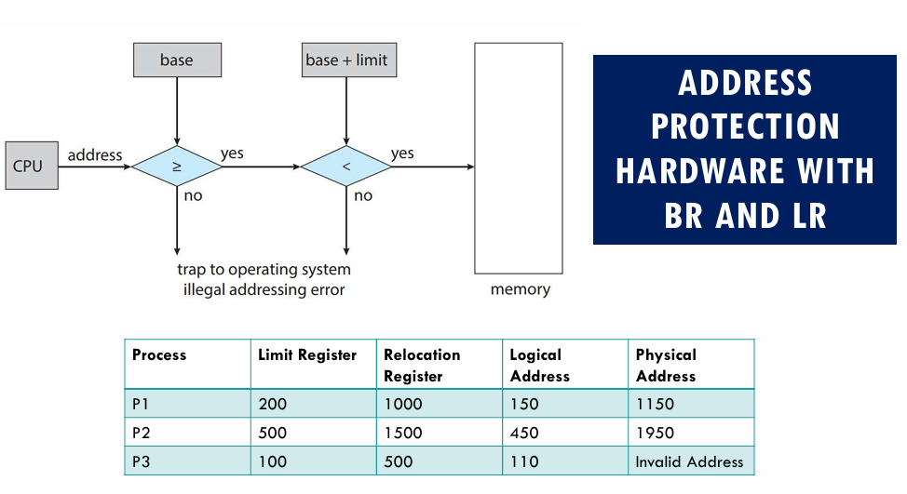
.

Slide 37
Cont..
The logical address generated by the CPU is first checked by the limit register,
If the value of the logical address generated is less than the value of the limit register,
The base address stored in the relocation register is added to the logical address to get the physical address of the memory location.
If the logical address value is greater than the limit register, then the CPU traps to the OS, and the OS terminates the program by giving fatal error.

Slide 38
STATIC AND DYNAMIC LOADING
Loading a process from hard disk into the main memory is done by a loader. There are two different types of loading :
Static Loading:
  Process of loading the entire program into a fixed address.
  Requires more memory space.
  Drawback- : The entire program and all data of a process must be in physical memory for the process to execute. So, the size of a process is limited to the size of physical memory.
  OR
  Loading the entire program into the main memory before the start of the program execution is called static loading.
  If static loading is used then accordingly static linking is applied.

Slide 39
STATIC AND DYNAMIC LOADING
Dynamic Loading
In dynamic loading , a routine is not loaded until it is called.
All routines reside on disk in a relocatable
OR
Loading the program into the main memory on demand is called dynamic loading.
If dynamic loading is used then accordingly dynamic linking is applied.
Advantages :
Unused routines are never loaded.
Useful when the program size is large

Slide 40
STATIC AND DYNAMIC LINKING
A linker is a program that takes one or more object files generated by a compiler and combines them into a single executable file.
Static Linking: In static linking, the linker combines all necessary program modules into a single executable program.
Dynamic Linking: In dynamic linking, “Stub” is included for each appropriate library routine reference.
  A stub is a small piece of code. When the stub is executed, it checks whether the needed routine is already in memory or not.
  If not available then the program loads the routine into memory.

Slide 41
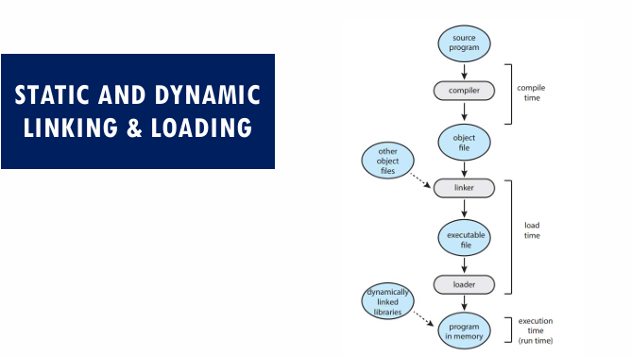
.

Slide 42
ADDRESS BINDING
Address binding is a process of mapping one address space to another.
The linker and loader binds the relocatable addresses to absolute addresses.
The binding of instructions and data to memory addresses can be done at any step (Compile Time/Load Time/Runtime):
Compile time Binding
  The starting address where the process will reside in the main memory is known at compile time
  If the starting location changes, then it will be necessary to recompile the code

Slide 43
ADDRESS BINDING
Load time Binding
If it is not known at compile time where the process will reside in memory, binding is delayed until load time.
If the starting address changes, we need only reload the user code to incorporate this changed value.
Execution time Binding
Binding is delayed until run time if a process is moved from one memory segment to another during its execution.
Most operating systems use this method

Slide 44
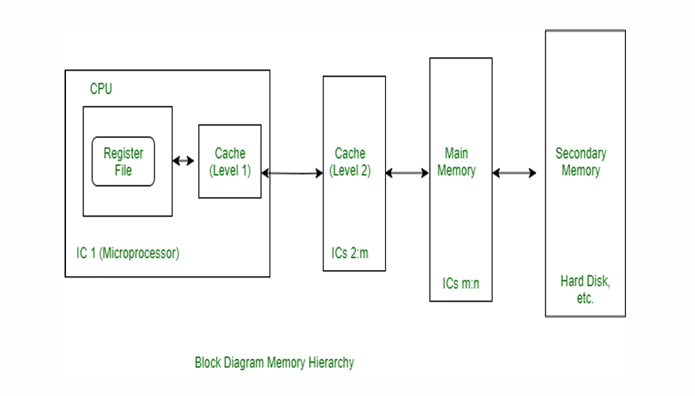
MEMORY HIERARCHY

Slide 45
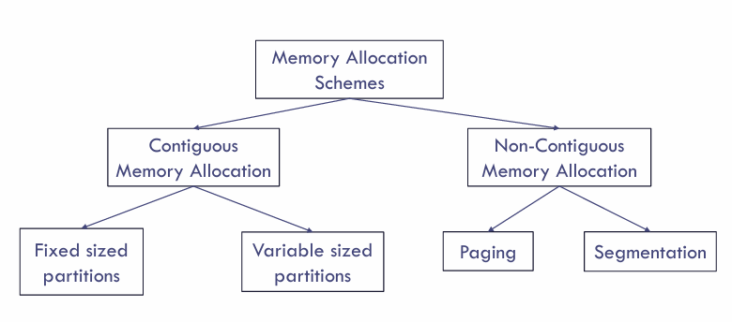
MEMORY ALLOCATION
Aims to allocate the required memory to each process by efficiently utilizing the memory space.

Slide 46
CONTIGUOUS MEMORY ALLOCATION
In contiguous memory allocation, a process is given a single block of contiguous memory locations to execute.
The entire process resides in one continuous section of the RAM.
OR
In contiguous memory allocation, each process is assigned a single continuous block of memory in the main memory. The entire process is loaded into one contiguous memory region.
In Contiguous Technique, executing process must be loaded entirely in the main memory.
Advantages:
This method is relatively simple to implement.
It simplifies memory addressing because processes are stored in contiguous blocks

Slide 47
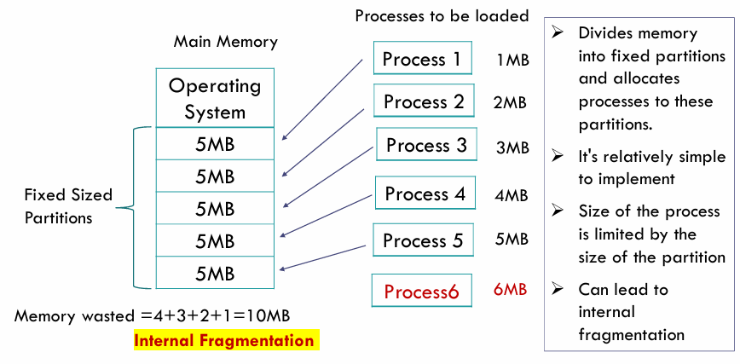
CONTIGUOUS MEMORY ALLOCATION: FIXED SIZED PARTITIONS (Static)

Slide 48
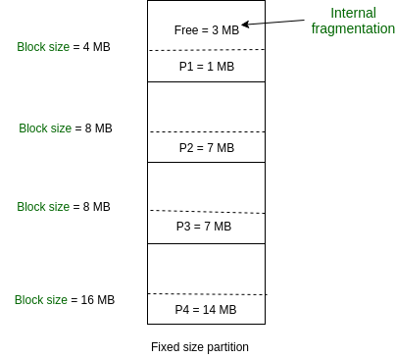
OR
This is the oldest and simplest technique used to put more than one process in the main memory. In this partitioning, the number of partitions (non-overlapping) in RAM is fixed but the size of each partition may or may not be the same. As it is a contiguous allocation, hence no spanning is allowed. Here partitions are made before execution or during system configure.
As illustrated in above figure, first process is only consuming
1MB out of 4MB in the main memory.
Hence, Internal Fragmentation in first block is (4-1) = 3MB.
Sum of Internal Fragmentation in every
block = (4-1)+(8-7)+(8-7)+(16-14)= 3+1+1+2 = 7MB.
Suppose process P5 of size 7MB comes.
But this process cannot be accommodated in spite of
available free space because of contiguous allocation
(as spanning is not allowed). Hence, 7MB becomes part
of External Fragmentation.

Slide 49
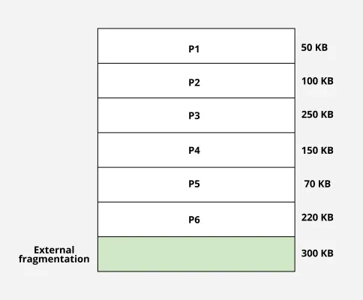
CONTIGUOUS MEMORY ALLOCATION: VARIABLE SIZED PARTITIONS (Dynamic)
In variable partition schema initially, the memory will be full contiguous free block
Memory divided into partitions according to the process size where process size will vary.
One partition is allocated to each active partition.
External Fragmentation is found in variable partition scheme.

Slide 50
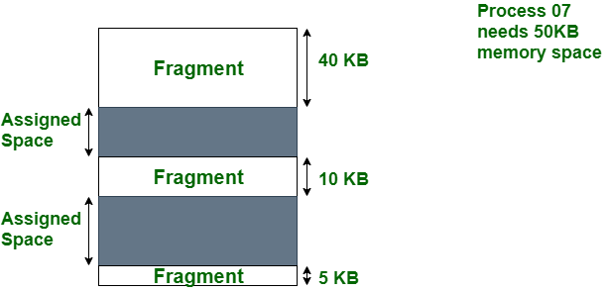
Cont..
In this diagram, we can see that, there is enough space (55 KB) to run a process-07 (required 50 KB) but the memory (fragment) is not contiguous. Here, we use compaction, paging, or segmentation to use the free space to run a process.

Slide 51
VARIABLE SIZED PARTITIONS: COMPACTION
The problem of external fragmentation can be solved by using a technique called compaction.
Compaction involves the overhead in terms of the time and processing power required for memory movement.
OR
Moving all the processes toward the top or towards the bottom to make free available memory in a single continuous place is called compaction. Compaction is undesirable to implement because it interrupts all the running processes in the memory. It also consumes CPU time (overhead).

Slide 52
ALGORITHMS FOR MEMORY ALLOCATION (USING THE HOLES)
First-Fit Memory Allocation: Allocate the first hole that is big enough
2. Best-Fit Memory Allocation: Allocate the smallest hole that is big enough
3. Worst-Fit Memory Allocation: Allocate the largest hole

Slide 53
Cont..
Consider six memory partitions of size 200 KB, 400 KB, 600 KB, 500 KB, 300 KB and 250 KB. These partitions need to be allocated to four processes of sizes 357 KB, 210 KB, 468 KB and 491 KB in that order. Perform the allocation of processes using
1.First Fit Algorithm
2.Best Fit Algorithm
3.Worst Fit Algorithm

Slide 54
Non-Contiguous Memory Allocation
Non-contiguous allocation, also known as dynamic or linked allocation, is a technique used in operating systems to allocate memory to processes that do not require a contiguous block of memory. Here a process is divided into parts and stored in different free blocks of main memory, not necessarily consecutive:
Process is split into smaller units (pages/segments).
These parts are placed in available free blocks (frames) of memory.
OS maintains mapping through page tables or segment tables
Note: These non-contiguous blocks of memory can be located anywhere in the physical memory.
Example
Suppose a process requires 12 KB memory.
In contiguous allocation, we need one continuous 12 KB block:
Physical Memory
| Process P | Process P | Process P | Process P |
<------------- 12 KB -------------->

Slide 55
Cont..
In non-contiguous allocation, the process can be divided into parts:
Physical Memory
| OS | P1 | P2 | Free | P3 | Other | P4 | Free |
Here: P1, P2, P3, P4 are different parts of the same process.
They are stored at different physical locations.
The OS keeps track of where each part is located.
3. Why do we need Non-Contiguous Allocation?
Consider physical memory:
| OS | Free 5 KB | Process A | Free 3 KB | Process B | Free 4 KB |
Suppose a new process requires 12 KB.
There is no single continuous 12 KB block.
But total free memory is: 5 + 3 + 4 = 12 KB
With non-contiguous allocation, the process can use these separate free areas.
| OS | P1 (5 KB) | A | P2 (3 KB) | B | P3 (4 KB) |
Therefore, non-contiguous allocation helps utilize available memory more efficiently.

Slide 56
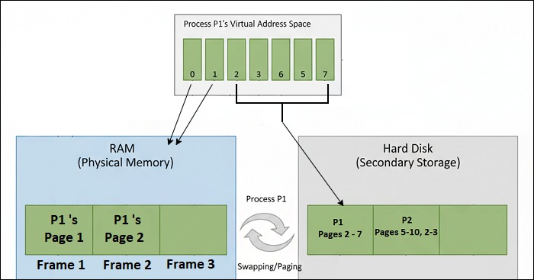
OR
Non-contiguous memory allocation is a memory allocation technique where a process is allocated multiple blocks of memory at different locations in the main memory. Sometimes the entire process may not be stored in the main memory. i.e., some parts of the process may be stored in the secondary storage (like hard disk). When the process needs to access a part of the program that is not in the main memory, the OS will immediately swap that part to the main memory.
The image below shows the main memory allocating storage to three processes P1, P2, and P3 using non-contiguous memory allocation

Slide 57
Cont..
In the image above, the process is divided into pages (Page 1, Page 2, Page 3, ... page 7). The first 2 pages are loaded into the physical memory (RAM), and rest are stored in the hard disk.
We have two types of non-contiguous memory allocation techniques
Paging
Segmentation

Slide 58
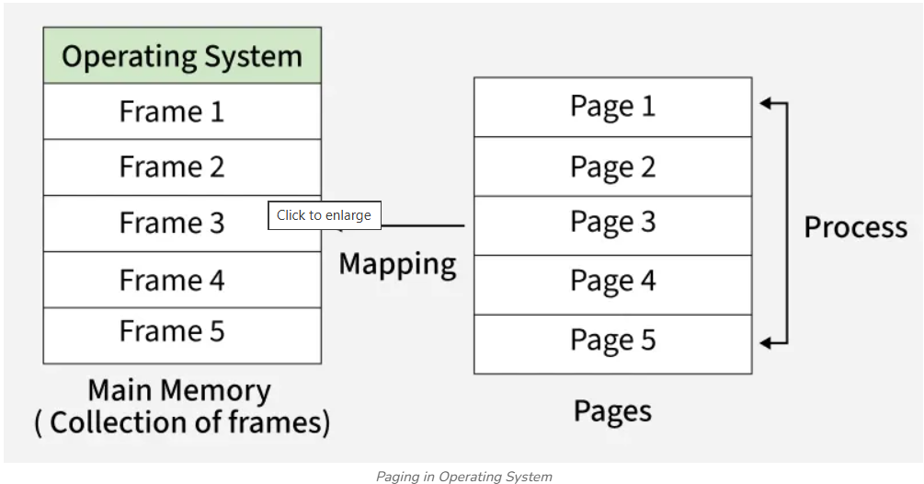
Paging
Paging is a memory management scheme that permits the physical address space of a process to be non-contiguous.
Support for paging is handled by hardware.
It is used to avoid external fragmentation.
Paging avoids the considerable problem of fitting the varying sized memory chunks on to the backing store. When some code or date residing in main memory need to be swapped out, space must be found on backing store.

Slide 59
OR Paging
Paging is a memory management technique in which a process is divided into fixed-size blocks called pages, and physical memory is divided into frames of the same size. Pages are loaded from secondary storage into main memory as needed.
A process does not need to be stored in contiguous memory locations.
The entire process does not need to be loaded into main memory at once; only required pages are loaded on demand. This allows efficient utilization of memory and supports execution of large programs.
Memory allocation is simplified because memory is managed in fixed-size pages and frames.

Slide 60
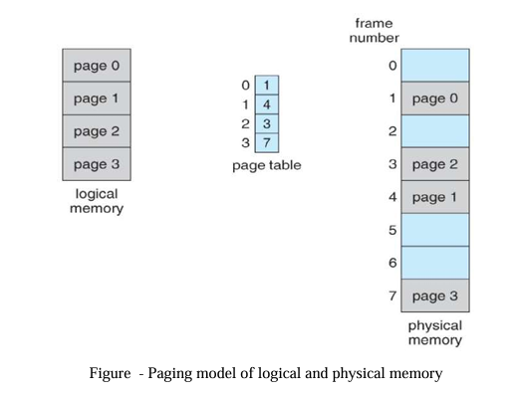
Basic Method
The basic idea behind paging is to divide physical memory into a number of equal sized blocks called frames, and to divide a programs logical memory space into blocks of the same size called pages.
Any page ( from any process ) can be placed into any available frame.
The page table is used to look up what frame a particular page is stored in at the moment. In the following example, for instance, page 2 of the program's logical memory is currently stored in frame 3 of physical memory:

Slide 61
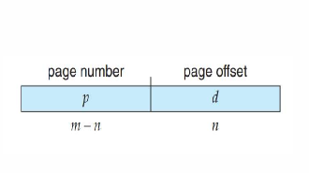
Cont..
When a process is to be executed, its pages are loaded into any available memory frames from the hard disk.
Every address generated by the CPU is divided into two parts: a page number (p) and a page offset (d):
The size of a page is a power of 2
2^𝑚-size of the logical address space
2^𝑛bytes - page size, then the
high-order m-n bits of a logical address
designate the page number, and the
n low-order bits designate the page offset.

Slide 62
Cont.. OR
A logical address consists of two parts: A page number in which the address resides, and an offset from the beginning of that page. ( The number of bits in the page number limits how many pages a single process can address. The number of bits in the offset determines the maximum size of each page, and should correspond to the system frame size. )
The page table maps the page number to a frame number, to yield a physical address which also has two parts: The frame number and the offset within that frame. The number of bits in the frame number determines how many frames the system can address, and the number of bits in the offset determines the size of each frame.
Page numbers, frame numbers, and frame sizes are determined by the architecture, but are typically powers of two, allowing addresses to be split at a certain number of bits. For example, if the logical address size is 2^m and the page size is 2^n, then the high-order m-n bits of a logical address designate the page number and the remaining n bits represent the offset.
Note also that the number of bits in the page number and the number of bits in the frame number do not have to be identical. The former determines the address range of the logical address space, and the latter relates to the physical address space.

Slide 63
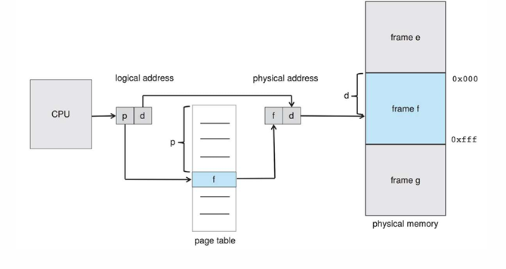
PAGING: ADDRESS TRANSLATION

Slide 64
PAGING: ADDRESS TRANSLATION
The page table contains the base address of each frame in physical memory, and the offset is the location in the frame being referenced.
Steps taken by the MMU to translate a logical address generated by the CPU to a physical address:
1. Extract the page number p and use it as an index into the page table.
2. Extract the corresponding frame number f from the page table
3. Replace the page number p in the logical address with the frame number f

Slide 65
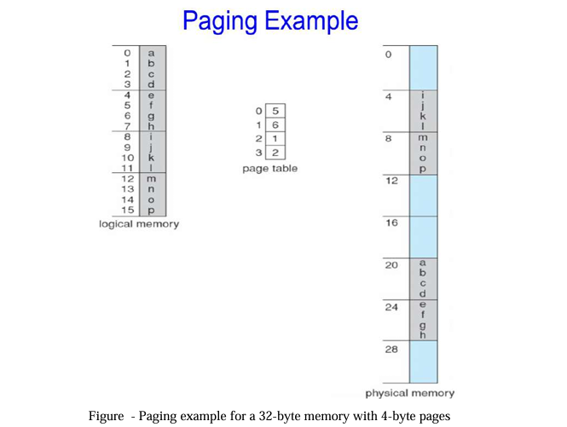
Paging Example
Consider the following micro example, in which a process has 16 bytes of logical memory, mapped in 4 byte pages into 32 bytes of physical memory. ( Presumably some other processes would be consuming the remaining 16 bytes of physical memory. )

Slide 66
Cont..
Note that paging is like having a table of relocation registers, one for each page of the logical memory.
There is no external fragmentation with paging. All blocks of physical memory are used, and there are no gaps in between and no problems with finding the right sized hole for a particular chunk of memory.
There is, however, internal fragmentation. Memory is allocated in chunks the size of a page, and on the average, the last page will only be half full, wasting on the average half a page of memory per process. ( Possibly more, if processes keep their code and data in separate pages. )
Larger page sizes waste more memory, but are more efficient in terms of overhead. Modern trends have been to increase page sizes, and some systems even have multiple size pages to try and make the best of both worlds.
Page table entries ( frame numbers ) are typically 32 bit numbers, allowing access to 2^32 physical page frames. If those frames are 4 KB in size each, that translates to 16 TB of addressable physical memory. ( 32 + 12 = 44 bits of physical address space. )
When a process requests memory ( e.g. when its code is loaded in from disk ), free frames are allocated from a free-frame list, and inserted into that process's page table.
Processes are blocked from accessing anyone else's memory because all of their memory requests are mapped through their page table. There is no way for them to generate an address that maps into any other process's memory space.

Slide 67
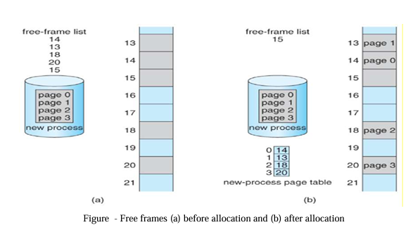
PAGE TABLE OF A PROCESS
Memory allocation for a new process
Page table of the process
Difference between programmer’s view of memory and the actual physical memory.

Slide 68
PAGING HARDWARE
As page tables are per-process data structures, a pointer to the page table is stored in the PCB of each process.
The hardware implementation of the page table can be done in several ways:
High-speed hardware registers
page-address translation is very efficient.
Increases context-switch time, as each one of these registers must be exchanged during a context switch.
Suitable if the page table is reasonably small (for example, 256 entries, Most contemporary CPUs support much larger page tables 2**20 entries)
Main Memory
The page table is kept in main memory, and a page-table base register (PTBR) points to the page table.
Changing page tables requires changing only this one register, substantially reducing context-switch time
Accessing page table from main memory is time consuming (2 Memory accesses)

Slide 69
PAGING HARDWARE: TRANSLATION LOOK-ASIDE BUFFER
TLB is a special, small, fast-lookup hardware cache
The TLB is associative, high-speed memory.
Each entry in the TLB consists of two parts: a key (or tag) and a value.
When the associative memory is presented with an item, the item is compared with all keys simultaneously.
If the item is found, the corresponding value field is returned

Slide 70
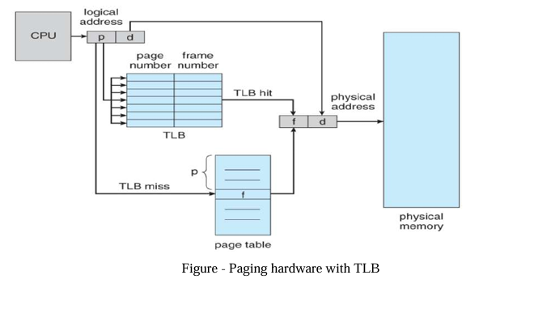
Cont..

Slide 71
Cont..
The TLB is used with page tables in the following way:
The TLB contains only a few of the page-table entries.
When a logical address is generated by the CPU, the MMU first checks if its page number is present in the TLB.
If the page number is found, its frame number is immediately available and is used to access memory.
If the page number is not in the TLB (known as a TLB miss), a memory reference to the page table must be made to obtain the frame number.
In addition, the page number and frame number are added to the TLB, so that they will be found quickly for the next reference.

Slide 72
OR
The only solution is to use special, fast, lookup hardware cache called translation look aside buffer [TLB] or associative register. LB is built with associative register with high speed memory. Each register contains two paths a key and a value.
When an associative register is presented with an item, it is compared with all the key values, if found the corresponding value field is return and searching is fast. TLB is used with the page table as follows:
TLB contains only few page table entries. When a logical address is generated by the CPU, its page number along with the frame number is added to TLB. If the page number is found its frame memory is used to access the actual memory. If the page number is not in the TLB (TLB miss) the memory reference to the page table is made. When the frame number is obtained use can use it to access the memory. If the TLB is full of entries the OS must select anyone for replacement. Each time a new page table is selected the TLB must be flushed [erased] to ensure that next executing process do not use wrong information. The percentage of time that a page number is found in the TLB is called HIT ratio.

Slide 73
Protection
Memory protection in paged environment is done by protection bits that are associated with each frame these bits are kept in page table.
x One bit can define a page to be read-write or read-only. To find the correct frame number every reference to the memory should go through page table. At the same time physical address is computed.
The protection bits can be checked to verify that no writers are made to read-only page. Any attempt to write in to read-only page causes a hardware trap to the OS.
This approach can be used to provide protection to read-only, read write or execute-only pages. One more bit is generally added to each entry in the page table: a valid-invalid bit.

Slide 74
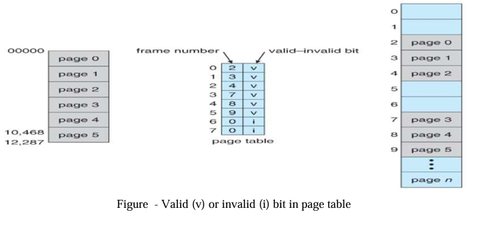
Cont..
A valid bit indicates that associated page is in the processes logical address space and thus it is a legal or valid page.
If the bit is invalid, it indicates the page is not in the processes logical addressed space and illegal. Illegal
addresses are trapped by using the valid-invalid bit.
The OS sets this bit for each page to allow or disallow accesses to that page.

Slide 75
Shared Pages
Paging systems can make it very easy to share blocks of memory, by simply duplicating page numbers in multiple page frames. This may be done with either code or data.
If code is reentrant, that means that it does not write to or change the code in any way ( it is non self-modifying ), and it is therefore safe to re-enter it. More importantly, it means the code can be shared by multiple processes, so long as each has their own copy of the data and registers, including the instruction register.
In the example given below, three different users are running the editor simultaneously, but the code is only loaded into memory ( in the page frames ) one time.
Some systems also implement shared memory in this fashion.

Slide 76
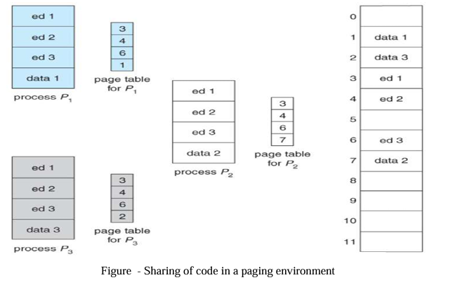
Cont..

Slide 77
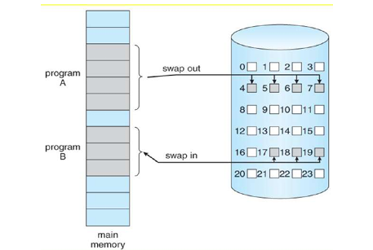
Demand Paging
The processes reside in Secondary Memory & pages one loaded only on demand not in advance.
Loading the pages whenever we needed.
Demand Paging is used in Virtual Memory system.
pages that are need for execution that are loaded into the memory.
Pages which are not accessed that are not loaded into the memory.
Swapper swaps entire process into the memory at a time but pager swaps individual pages into the memory.
Here we use lazy swapper to swap the pages that are needed into the memory.

Slide 78
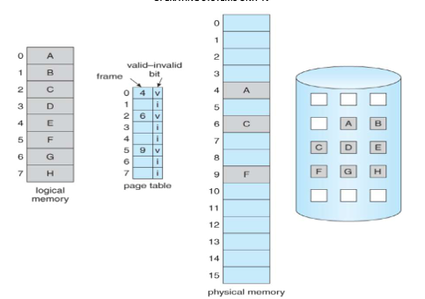
Implementation of demand paging
The Entry bit (valid- invalid) scheme is used in the page map table to distinguish between those pages that in the memory and those pages that are on the disk
entry bit Valid it indicates that the pages are legal and in memory.
entry bit Invalid it indicates that the pages are not valid and valid but is currently on the disk.

Slide 79
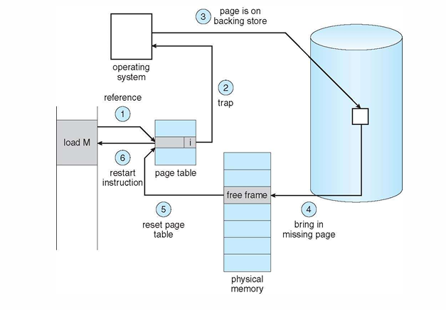
PAGE FAULT
When the process tries to access a page that is not available un the memory or marked as invalid, it is called as a page fault
OR If the page is not present in main memory, then we call it as page fault.
Page fault handling procedure:

Slide 80
Cont..
The memory address which is requested by the process is first checked, to verify the request made by the process.
If it's found to be invalid, the process is terminated. Otherwise, the page must be paged in.
A free frame is located, possibly from a free-frame list.
A disk operation is scheduled to bring the necessary page from disk.
The process's page table is updated with the new frame number, and the invalid bit is changed to valid.
The instruction that caused the page fault must now be restarted.
There are cases when no pages are loaded into the memory initially, pages are only loaded when demanded by the process by generating page faults. This is called Pure Demand Paging
Performance of demand paging
P - is the probability of page fault (0<=P<=1)
EAT is the effective access time
ma- Memory access time
EAT = (1-p) X ma + PX page fault time

Slide 81
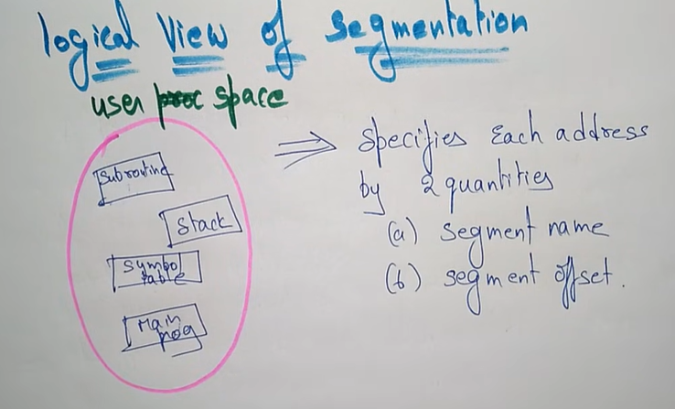
Segmentation
A program is a collection of segments.
A segment is a logical unit such as main program, procedure, function, local variable, global variable, common blocks, stacks, symbol table, arrays.

Slide 82
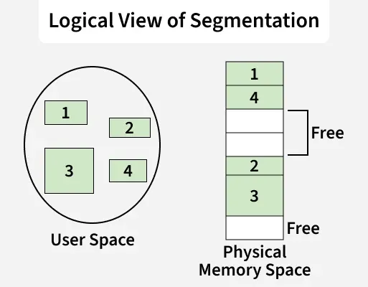
Cont..
Segmentation is a memory management technique in which a process is divided into variable-sized units called segments, where each segment represents a logical part of a program such as functions, arrays, or modules. It follows the user’s logical view of memory and allows flexible organization, protection, and sharing of data.
Divides a process into variable-sized logical segments
Each segment represents a program unit like function or array
Uses a segment table for address translation (base and limit)
Supports flexibility, protection, and sharing of memory

Slide 83
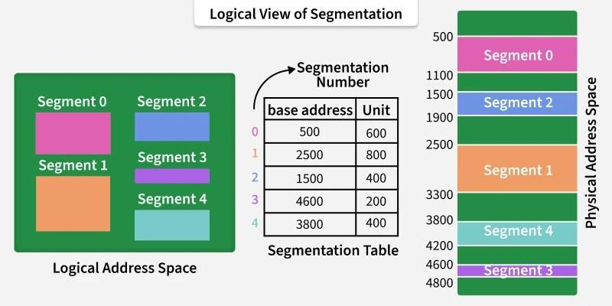
Segment Table
Used to map a two-part logical address ⟨segment number, offset⟩ to a one-dimensional physical address. Each segment has an entry in the table. Each table entry contains:
Base Address: Starting physical address of the segment in memory.
Segment Limit: Size (length) of the segment; used to check whether the offset is within valid range.

Slide 84
Hardware support
We must define an implementation to map 2D user defined address in to 1D physical address. This mapping is affected by a segment table. Each entry in the segment table has a segment base and segment limit. The segment base contains the starting physical address where the segment resides and limit specifies the length of the segment.

Slide 85
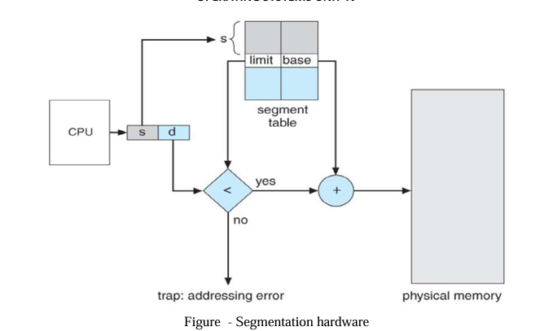
Cont..

Slide 86
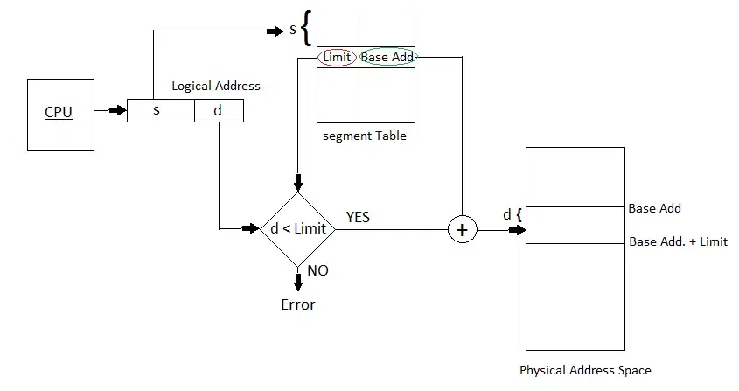
OR

Slide 87
Cont..
The use of segment table is shown in the above figure: Logical address consists of two parts: segment number‘s’ and an offset ‘d’ to that segment. The segment number is used as an index to segment table. The offset ’d’ must be in between 0 and limit, if not an error is reported to OS. If legal the offset is added to the base to generate the actual physical address. The segment table is an array of base limit register pairs.
The address generated by the CPU is divided into:
Segment number (s): Number of bits required to represent the segment.
Segment offset (d): Number of bits required to represent the position of data within a segment.

Slide 88
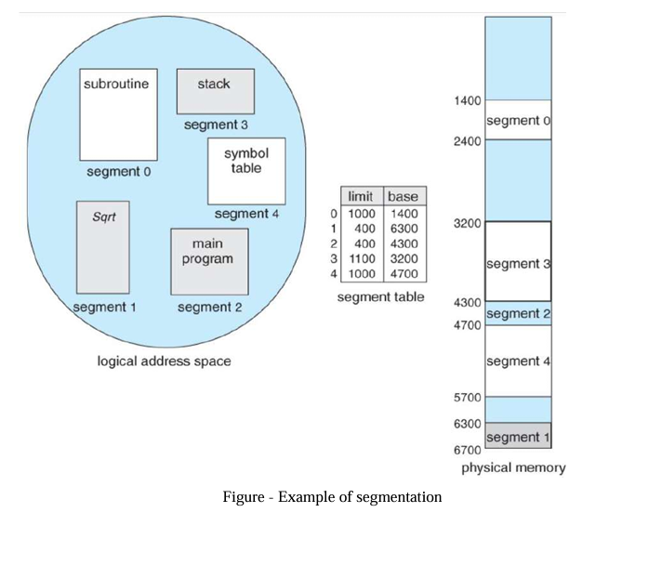
cont..

Slide 89
Differences between segmentation and paging
Segmentation:
Program is divided in to variable sized segments. x User is responsible for dividing the program in to segments.
Segmentation is slower than paging.
Visible to user.
Eliminates internal fragmentation.
Suffers from external fragmentation.
Process or user segment number, offset to calculate absolute address.
Paging:
Programs are divided in to fixed size pages.
Division is performed by the OS.
Paging is faster than segmentation.
Invisible to user.
Suffers from internal fragmentation.
No external fragmentation.
Process or user page number, offset to calculate absolute address

Slide 90
page replacement algorithms
Page replacement is a technique used in virtual memory when a page fault occurs and all available frames in main memory are occupied.
The Operating System must decide:
Which page should be removed from memory to make space for the new page?
Basic Process
  CPU generates a logical/virtual address.
  OS checks whether the required page is in main memory.
  If the page is present → Page Hit.
  If the page is absent → Page Fault.
  If a free frame exists → load the page into it.
  If no free frame exists → use a page replacement algorithm.
  Select a victim page.
  Remove the victim page.
  Load the required page.
  Continue execution.

Slide 91
Cont..
Prevent over-allocation of memory by modifying page-fault service routine to include page replacement
Use modify (dirty) bit to reduce overhead of page transfers – only modified pages are written to disk
Page replacement completes separation between logical memory and physical memory – large virtual memory can be provided on a smaller physical memory

Slide 92
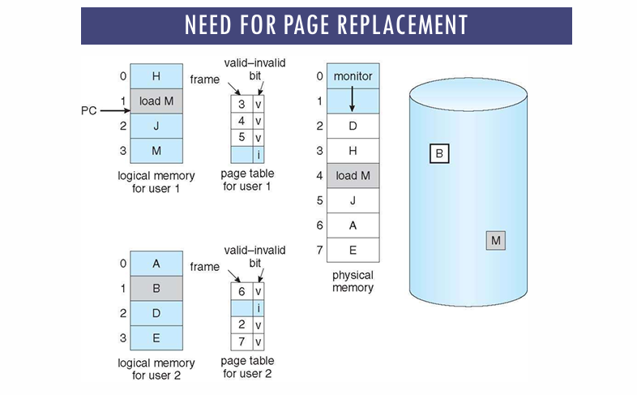
NEED FOR PAGE REPLACEMENT

Slide 93
Basic Page Replacement
The previously discussed page-fault processing assumed that there would be free frames available on the free-frame list. Now the page-fault handling must be modified to free up a frame if necessary, as follows:
1. Find the location of the desired page on the disk, either in swap space or in the file system.
2. Find a free frame:
a. If there is a free frame, use it.
b. If there is no free frame, use a page-replacement algorithm to select an existing frame to be replaced, known as the victim frame.
c. Write the victim frame to disk. Change all related page tables to indicate that this page is no longer in memory.
3. Read in the desired page and store it in the frame. Adjust all related page and frame tables to indicate the change.
4. Restart the process that was waiting for this page.

Slide 94
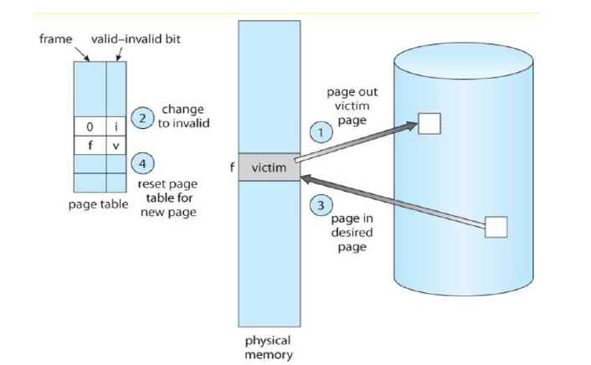
Cont..

Slide 95
Cont..
Common Page Replacement Techniques
First In First Out (FIFO)
Optimal Page replacement
Least Recently Used (LRU)
Most Recently Used (MRU)
FIFO Page Replacement Algorithm
FIFO = First-In, First-Out
In FIFO page replacement, the page that entered memory first is removed first.
Think of it like a queue: First entered → First removed
                OR
This is the simplest page replacement algorithm. In this algorithm, the operating system keeps track of all pages in the memory in a queue, the oldest page is in the front of the queue. When a page needs to be replaced page in the front of the queue is selected for removal.

Slide 96
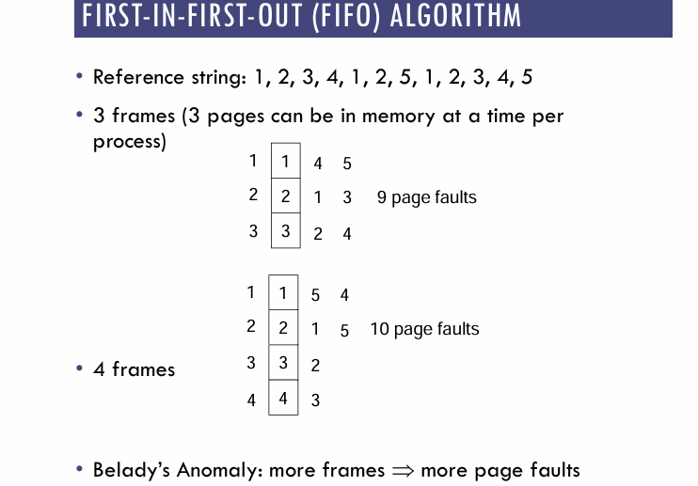
Cont..

Slide 97
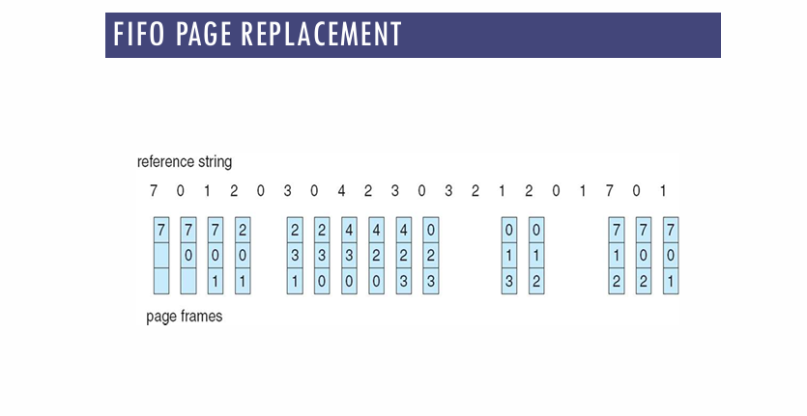
Cont..

Slide 98

Cont..
EX- 2
Initially, all slots are empty, so when 1, 3, 0 came they are allocated to the empty slots ---> 3 Page Faults.
When 3 comes, it is already in memory so ---> 0 Page Faults.
Then 5 comes, it is not available in memory, so it replaces the oldest page slot i.e 1. ---> 1 Page Fault.
6 comes, it is also not available in memory, so it replaces the oldest page slot i.e 3 ---> 1 Page Fault.
Finally, when 3 come it is not available, so it replaces 0 1-page fault.

Slide 99
Cont..
Advantages
Simple and easy to implement.
Low overhead.
Disadvantages
Poor performance.
Doesn’t consider the frequency of use or last used time, simply replaces the oldest page.
Suffers from Belady’s Anomaly(i.e. more page faults when we increase the number of page frames).

Slide 100
Belady's anomaly
Belady’s anomaly proves that it is possible to have more page faults when increasing the number of page frames while using the First in First Out (FIFO) page replacement algorithm. For example, if we consider reference string 3, 2, 1, 0, 3, 2, 4, 3, 2, 1, 0, 4 and 3 slots, we get 9 total page faults, but if we increase slots to 4, we get 10 page faults.

Slide 101

Least Recently Used (LRU) Page Replacement
LRU replaces the page that has not been used for the longest time.
Simple idea :"Remove the page that was used least recently."
                OR
In this algorithm, page will be replaced which is least recently used.
Example Consider the page reference string 7, 0, 1, 2, 0, 3, 0, 4, 2, 3, 0, 3, 2, 3 with 4-page frames. Find number of page faults using LRU Page Replacement Algorithm.

Slide 102

Cont..
Initially, all frames are empty. When 1, 3, 0 arrive, they are placed in empty frames, resulting in 3 page faults.
When 3 arrives again, it is already present in memory, so there is no page fault.
When 5 arrives, it is not in memory, so it replaces the oldest page (1), resulting in 1 page fault.
When 6 arrives, it is not in memory, so it replaces the oldest page (3), resulting in 1 page fault.
Finally, when 3 arrives, it is not in memory, so it replaces the oldest page (0), resulting in 1 page fault.
Total Page Faults = 6
EX – 2

Slide 103
cont..
Advantages
Efficient.
Doesn't suffer from Belady’s Anomaly.
Disadvantages
Complex Implementation.
Expensive.
Requires hardware support.

Slide 104
Optimal Page Replacement Algorithm
Optimal Page Replacement is one of the Algorithms of Page Replacement. In this algorithm, pages are replaced which would not be used for the longest duration of time in the future.
OR
Optimal Page Replacement algorithm is the best page replacement algorithm as it gives the least number of page faults. It is also known as OPT, clairvoyant replacement algorithm, or Belady’s optimal page replacement policy.
In this algorithm, pages are replaced which would not be used for the longest duration of time in the future, i.e., the pages in the memory which are going to be referred farthest in the future are replaced.
This algorithm was introduced long back and is difficult to implement because it requires future knowledge of the program behaviour. However, it is possible to implement optimal page replacement on the second run by using the page reference information collected on the first run.

Slide 105

Cont..

Slide 106

Cont..
Example 2:
Input: Number of frames = 3, Reference String = {7, 0, 1, 2, 0, 3, 0, 4, 2, 3}
Page-by-page analysis:
7, 0, 1, 2: First four pages fill the frames → Misses = 4
0: Already in the frame → Hit
3: Replaces 7 (not used for the longest) → Miss
0: Already in the frame → Hit
4: Replaces 1 → Miss
2, 3: All already in frames → Hits = 2
Final Tally:
Hits = 4
Misses = 6

Slide 107

Cont..
Example 3:
Input: Number of frames = 3, Reference String = {6, 7, 8, 9, 6, 7, 1, 6, 7, 8, 9, 1, 7, 9, 6}

Slide 108
Cont..
Advantages
Easy to Implement.
Simple data structures are used.
Highly efficient.
Disadvantages
Requires future knowledge of the program.
Time-consuming.

Slide 109

Most Recently Used (MRU) Page Replacement
MRU is a page replacement algorithm that removes the page that was used most recently.
            OR
In this algorithm, page will be replaced which has been used recently. Belady's anomaly can occur in this algorithm.
Example 1: Consider the page reference string 7, 0, 1, 2, 0, 3, 0, 4, 2, 3, 0, 3, 2, 3 with 4-page frames. Find number of page faults using MRU Page Replacement Algorithm.

Slide 110

Cont..
EX -2

Slide 111
Read/Write Permissions
The OS controls what a process is allowed to do with a memory page.
Common permissions are:
Read Permission : If a page has Read permission, the process can read its contents.
Example:
Page:
+----------------+
| 100 200 300|
+----------------+
Process → READ → Allowed ✓
Permission | Meaning
Read (R) | Process can read data
Write (W) | Process can modify data
Execute (X) | Process can execute instructions

Slide 112
Cont..
Write Permission
If a page has Write permission, the process can modify its contents.
Example:
Page:
+----------------+
| 100 200 300 |
+----------------+
Process → WRITE → Allowed ✓

Slide 113
Cont..
Suppose a page is shared by two processes:
P1 ──READ──┐
↓
+---------+
| Shared |
| Page |
+---------+
↑
P2 ──READ──┘
Both processes can read it.
But if P1 tries to modify it:
P1 → WRITE → ❌ Not allowed
The OS generates a protection fault.

Slide 114
Secondary Memory Management: Disk structure
What is Secondary Memory?
Secondary memory is used to store data and programs permanently.
Unlike RAM, secondary storage keeps data even when the computer is turned off.
Examples
Hard Disk Drive (HDD)
Solid State Drive (SSD)
USB flash drive
Memory card
Optical disk
In Operating Systems, disk management is an important part of secondary memory management.

Slide 115
Disk Structure
A disk is organized into different physical and logical parts so that the operating system can efficiently store and retrieve data.
For a traditional Hard Disk Drive (HDD), the main components are:
Platters
Tracks
Sectors
Cylinders
Read/Write Heads
A hard disk drive (HDD) is a fixed storage device inside a computer that uses magnetic technology to retrieve and store digital data for long-term. Unlike RAM, HDDs retain data even when powered off, making them essential for operating systems, applications and files.

Slide 116

Cont..

Slide 117

Cont..

Slide 118

Cont..

Slide 119
Cont..
Platter
A platter is a circular disk inside an HDD on which data is stored.
Usually made of a rigid material.
It is coated with a magnetic material.
Platters rotate at high speed.
OR
Magnetic platters are disk-like in shape and used to store data. Typically, they are made from glass or aluminium and laid down on a spindle where layers of such disks are kept one after the other.
Example: An HDD can contain multiple platters.
_____________
/ \
/ \
| ● |
\ /
\_______________/
● = Spindle

Slide 120
Cont..
Track
A track is a circular path on the surface of a platter where data is stored.
Think of tracks like the circular lines on a CD.
┌─────────────────┐
│ ┌─────────┐ │
│ │ ┌─────┐ │ │
│ │ │ ● │ │ │
│ │ └─────┘ │ │
│ └─────────┘ │
└─────────────────┘
Each circle = Track
A platter contains many tracks.

Slide 121
Cont..
Sector
A sector is a small portion of a track.
It is the basic physical storage unit of a traditional disk.
Track
___________
.-' | '-.
.' | '.
/ \ | / \
|-------\---●--- /-------|
\ \ | / /
'. \ | / .'
'-.____\|/____.-'
↑
Sectors
A common sector size is 512 bytes, although modern disks may use 4096-byte sectors.

Slide 122
Cont..
Cylinder
A cylinder is a collection of tracks at the same radius across all platter surfaces.
Suppose an HDD has three platters:
Platter 1: Track 5
Platter 2: Track 5
Platter 3: Track 5
↓
Together = Cylinder 5
So:
Cylinder = Same-numbered track on all platter surfaces
This concept is particularly important for understanding traditional HDD geometry.

Slide 123
Cont..
Read/write Head:
The read/write arm controls the movement of the read/write heads, that perform the actual reading and writing on the disc platters.
OR
The read/write head is used to read data from and write data to the disk.
Each platter surface generally has a corresponding head.
Head
↓
─────────
↓
┌───────────┐
│ Platter │
└───────────┘
The head moves across the platter to reach the required track.

Slide 124
Cont..
Spindle:
The spindle maintains the platters in place and rotates them as required. The Revolution Per Minute(RPM) rating controls how fast data can be written to and read from the hard drive.
OR
The spindle is the central shaft that rotates the platters.
┌───────────────┐
│ Platter │
│ ● │
└───────────────┘
↑
Spindle
The spindle rotates the platters at a particular speed, such as 5400 RPM or 7200 RPM.

Slide 125
Cont..
Disk Arm
The disk arm moves the read/write head to the required track.
Read/Write Head
↓
●
/
/
/
/
●
Disk Arm
When the OS requests data, the disk arm positions the head over the appropriate track.

Slide 126
Disk Scheduling
A process needs two type of time, CPU time and IO time. For I/O, it requests the Operating system to access the disk.
However, the operating system must be fare enough to satisfy each request and at the same time, operating system must maintain the efficiency and speed of process execution.
The technique that operating system uses to determine the request which is to be satisfied next is called disk scheduling.
Seek time
Seek time is the time taken in locating the disk arm to a specified track where the read/write request will be satisfied.
Rotational latency
It is the time taken by the desired sector to rotate itself to the position from where it can access the R/W heads.
Transfer Time
It is the time taken to transfer the data.

Slide 127
Cont..
Disk Access Time
Disk access time is given as,
Disk Access Time = Rotational Latency + Seek Time + Transfer Time
Disk Response Time
It is the average of time spent by each request waiting for the IO operation.
Purpose of Disk Scheduling
The main purpose of disk scheduling algorithm is to select a disk request from the queue of IO requests and decide the schedule when this request will be processed.
Goal of Disk Scheduling Algorithm
  Fairness
  High throughout
  Minimal traveling head time

Slide 128
Disk Scheduling Algorithms
The list of various disks scheduling algorithm is given below. Each algorithm is carrying some advantages and disadvantages. The limitation of each algorithm leads to the evolution of a new algorithm.
FCFS scheduling algorithm
SSTF (shortest seek time first) algorithm
SCAN scheduling
C-SCAN scheduling
LOOK Scheduling
C-LOOK scheduling

Slide 129
FCFS scheduling algorithm
First-come first served scheduling follow first in first out method
It serves the request in the same order as they are received
The average waiting time for FCFS is often quite long. It is non-preemptive
In the below example the disk head is initially at cylinder 53, it will first move 53 to 98 then to 183,37,122,14,124,65 and finally to 67 for a total head movement of 640 cylinders.

Slide 130

Cont..

Slide 131

Ex - 2
Suppose the order of request is- (82,170,43,140,24,16,190) And current position of Read/Write head is: 50

Slide 132
SSTF (shortest seek time first) algorithm
Selects the request with the minimum seek time from the current head position.
SSTF scheduling is a form of SJF scheduling; may cause starvation of some requests
Illustration shows total head movement of 236 cylinders.

Slide 133

Cont..

Slide 134

Ex - 2
Suppose the order of request is- (82,170,43,140,24,16,190) And current position of Read/Write head is: 50

Slide 135
SCAN scheduling
The disk arm starts at one end of the disk, and moves toward the other end, servicing requests until it gets to the other end of the disk, where the head movement is reversed and servicing continues.
Sometimes called the elevator algorithm.
The head starts at the one end of the disk and moves toward on the another end. it serves all the request coming in the way.
After reaching another end the direction of head movement is reverse
Illustration shows total head movement of 236 cylinders.

Slide 136

Cont..

Slide 137

Ex - 2
Suppose the order of request is- (82,170,43,140,24,16,190) And current position of Read/Write head is: 50

Slide 138
C-SCAN [Circular SCAN] SCHEDULING
The circular SCAN algorithm improves upon SCAN b treating all the request in a circular queue fashion.- once the head reaches the end of the disk, it returns to the other end without processing any request, and then starts again from the beginning of the disk.
The head moves from one end of the disk to the other. servicing requests as it goes. When it reaches the other end, however, it immediately returns to the beginning of the disk, without servicing any requests on the return trip
Treats the cylinders as a circular list that wraps around from the last cylinder to the first one.
Illustration shows total head movement of 382 cylinders, plus return time.
Provides a more uniform wait time than SCAN.

Slide 139

Cont..

Slide 140

Ex - 2
Suppose the order of request is- (82,170,43,140,24,16,190) And current position of Read/Write head is: 50

Slide 141
LOOK scheduling
it is same like SCAN scheduling but the difference that end points are not visited unnecessary.
Arm only goes as far as the last request in each direction, then reverses direction immediately, without first going all the way to the end of the disk.
Advantages :
More efficient than FCFS.
No starvation for any request.
No extra head movement.
Disadvantages :
Not so fair, because cylinder behind the head with longer.

Slide 142

Cont..
Suppose the order of request is- (82,170,43,140,24,16,190) And current position of Read/Write head is: 50

Slide 143

Ex - 2

Slide 144

C-LOOK scheduling
Version of C-SCAN
Arm only goes as far as the last request in each direction, then reverses direction immediately, without first going all the way to the end of the disk.
(183 – 53) + (183 – 14) + (37 – 14) = 322

Slide 145

Ex - 2
Suppose the order of request is- (82,170,43,140,24,16,190) And current position of Read/Write head is: 50

Slide 146
PROBLEMS ON DISK SCHEDULING
1. Consider a disk with 100 tracks numbered from 0 to 99. The disk arm is currently at track 50, and the queue of pending disk requests is 82, 17, 90, 43, 68. If the disk scheduling algorithm is Shortest Seek Time First (SSTF), what is the order in which the requests will be serviced?
2. Assume a disk with 200 tracks and a disk scheduling queue with requests at tracks 25, 120, 65, 10, 150. If the disk arm is initially at track 50 and we use the SCAN algorithm, what is the order of servicing the requests?
3. Compare the advantages and disadvantages of FCFS, SSTF, SCAN, and C-LOOK disk scheduling algorithms. Explain under what conditions each algorithm may perform well or poorly.

Slide 147
Disk management
Disk provides low-cost, non-volatile storage
Eg. Magnetic tape, optical media, flash drives, etc.
OS is responsible for allocating space for files on secondary storage
Files may or may not be stored in contiguous locations on physical disk drives. But, OS hides the fact that the file is fragmented into multiple parts.
OS is able to locate each file and perform read and write operations on it
OS is responsible for:
Configuring the file system
Ensuring the safety and reliability of read and write operations to secondary storage
Maintaining access times

Slide 148
Cont..
Disk management of the operating system includes:
Disk Format
Booting from disk
Bad block recovery

Slide 149
DISK FORMAT
Disk formatting refers to the process of preparing a data storage device, such as a hard disk drive (HDD) or a solid-state drive (SSD), for initial use or for re-use.
There are two main types of disk formatting:
  low-level formatting
  high-level formatting.
Low-Level Formatting OR Physical Formatting:
1. It is a process that initializes the disk at the hardware level.
2. It prepares the disk for high-level formatting and ensures that the storage medium is ready for data storage.
3. It creates the physical structures on the disk, such as tracks and sectors.
4. Divides the disk into sectors with headers, data, and error correction codes (ECC).
5. It is rarely performed by end-users today,
6. Modern hard drives come pre-formatted from the factory

Slide 150
Cont..
High-Level Formatting OR Logical formatting:
1. It prepares the disk for storing files and managing data access.
2. It involves creating the file system, which includes the directory structure and file allocation tables, on the disk.
3. High-level formatting erases any existing data on the disk and prepares it to store new data.
4. The choice of file system (e.g., NTFS, FAT32, exFAT on Windows; ext4, XFS, or others on Linux) is made during high-level formatting.

Slide 151

BOOTING FROM DISK
1.Booting from a disk means starting up a computer by
reading a special section called the boot block
(Bootstrap program) on the hard drive.
2. This boot block contains important instructions
for the computer to begin working.
3. The bootstrap program loads the OS kernel into
memory when the computer is powered on.
4. A small bootstrap loader resides in ROM.
5. The full bootstrap code is stored in the boot
block of the disk.
6. A disk with a boot partition is called a boot
disk (system disk).

Slide 152
Cont..
7. When you turn on the computer, it looks for this boot block and follows the instructions in the boot block, which tell it where to find the main programs like the operating system.
8. Bootstrap is stored in ROM and hence it cannot be infected by a computer virus.
9. Modification of this bootstrap code requires changing the ROM hardware chips.
10. Solution: To store a small bootstrap loader program in the boot ROM which invokes and bring full bootstrap program from disk into main memory.
11. The modified version of full bootstrap program can be simply written onto the disk.
12. The fixed storage location of full bootstrap program is in the “boot blocks”.
13.A disk that has a boot partition is called a boot disk or system disk.

Slide 153
BAD BLOCKS
1.Bad blocks are sections of a storage device, like a hard disk or SSD, that are defective or unreliable for data storage.
2.These blocks can result from physical damage, manufacturing flaws, or other issues, causing errors when attempting to read or write data.
3. Modern storage devices often use error detection and correction techniques, such as ECC, to identify and mark bad blocks.
4. bad blocks can impact performance, leading to slower read and write speeds
5. Disk checking tools in operating systems help identify and manage bad blocks
Disks often have bad sectors due to manufacturing defects or usage.
Handled using:
Sector sparing (replacement): faulty sectors are replaced with spare ones.
Error recovery: for soft errors.
Manual intervention: required for hard errors

Slide 154
BUFFERING
1. Bad blocks are sections of a storage device, like a hard disk or SSD, that are defective or unreliable for data storage.
2. These blocks can result from physical damage, manufacturing flaws, or other issues, causing errors when attempting to read or write data.
3. Modern storage devices often use error detection and correction techniques, such as ECC, to identify and mark bad blocks.
4. bad blocks can impact performance, leading to slower read and write speeds
5. Disk checking tools in operating systems help identify and manage bad blocks

Slide 155

SWAP SPACE MANAGEMENT

Slide 156

Cont..

Slide 157

Cont..

Slide 158

Cont..

Slide 159

Cont..

Slide 160
RAID LEVELS
1. Redundant array of independent disks
2. The term was coined by David Patterson, Garth A. Gibson, and Randy Katz at the University of California, Berkeley in 1987.
3. RAID is a technique that makes use of a combination of multiple disks instead of using a single disk for increased performance, data redundancy, or both.
4. Data redundancy, although taking up extra space, adds to disk reliability.
5. Reliability, Availability, Performance and Capacity
6. Transparent to the system/users
RAID - Redundant Array of Inexpensive Disks Or Redundant Array Of Independent Disks
RAID is a technique to storing the same data in different places on multiple hard disks or
solid-state drives (SSDs) to protect data in the case of a drive failure.

Slide 161
RAID DATA STORAGE : TERMINOLOGY
Striping:
Splitting the flow of data into blocks of a certain size (called “block size”) then writing of these blocks across the RAID one by one. (affects performance.)
Mirroring
It is a storage technique in which the identical copies of data are stored on the RAID members simultaneously. (affects the fault tolerance & performance.)
Parity
It is a storage technique which uses striping and checksum methods. In parity technique, a certain parity function is calculated for the data blocks. If a drive fails, the missing block are recalculated from the checksum (provides fault tolerance)
Block
It is the physical location on the disk where data is written.

Slide 162

RAID Controller

Slide 163

Cont..

Slide 164

RAID LEVELS: RAID 0

Slide 165


Cont..

Slide 166

RAID LEVELS: RAID 1

Slide 167


Cont..

Slide 168

RAID LEVELS: RAID 2

Slide 169

Cont..

Slide 170

RAID LEVELS: RAID 3

Slide 171

Cont..

Slide 172

Cont..

Slide 173

RAID LEVELS: RAID 4

Slide 174

Cont..
RAID-4 introduces block-level striping across multiple disks, combined with a dedicated parity disk to provide fault tolerance. Data is written in blocks and a separate disk stores parity information calculated using the XOR function. This setup allows for data recovery in case of a single disk failure, making RAID-4 more reliable than RAID-0 but less efficient in write-intensive scenarios due to reliance on a dedicated parity disk.
In the figure, we can observe one column (disk) dedicated to parity

Slide 175

Cont..
Parity is calculated using a simple XOR function. If the data bits are 0,0,0,1 the parity bit is XOR(0,0,0,1) = 1. If the data bits are 0,1,1,0 the parity bit is XOR(0,1,1,0) = 0. A simple approach is that an even number of ones results in parity 0 and an odd number of ones results in parity 1.

Slide 176

Cont..

Slide 177

RAID LEVELS: RAID 5

Slide 178

Cont..

Slide 179

Cont..

Slide 180

RAID LEVELS: RAID 6

Slide 181

Cont..

Slide 182

Cont..

Slide 183

Cont..

Slide 184

RAID LEVELS: RAID 10 ( 1 + 0)

Slide 185

RAID LEVELS: RAID 01 ( 0 + 1)

Slide 186
.
Thank you…

